Slide 1
INTERNSHIP STUDIO INTERNSHIP FOR ETHICAL HACKING TASK-3

Slide 2
STEPS :
Launch Burp Suite and configure it to run its proxy service, noting the address and port
Open Firefox, then adjust its network settings so all browser traffic is directed through Burp Suite’s proxy.
Enable Burp Suite’s intercept feature to capture and control browser requests.
Navigate to http://testasp.vulnweb.com in Firefox while intercept is active.
When Burp Suite intercepts a request from Firefox, manually forward it so the page loads in the browser.
Locate the search box on the site and input the XSS payload, such as <script>alert(1)</script>. Submit the search.
Intercept the resulting request in Burp Suite, then send this captured request to the Intruder module for further testing and payload automation.
This set of instructions covers the same process but uses different phrasing and structure to explain the workflow.

Slide 3
Within the Intruder tab in Burp Suite, input multiple XSS payloads into the attack configuration and initiate the attack sequence to automatically test each script.
Review the Intruder results to identify which payloads triggered a successful XSS response. For each working payload, copy the server’s response and paste it into Firefox’s browser address bar or open the relevant page in Firefox. Observe the effect to confirm whether the script executes as intended.
For instance, if the <script>alert(1)</script> payload is successful, the browser should show a pop-up alert, confirming the script injection vulnerability.

Slide 4
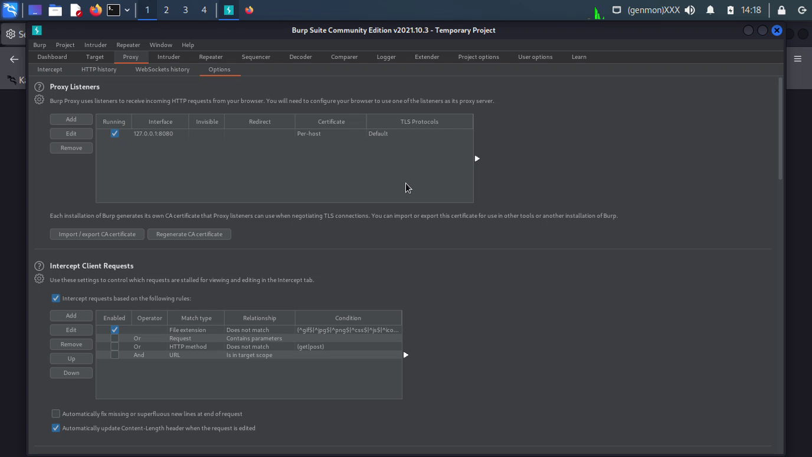

Slide 5
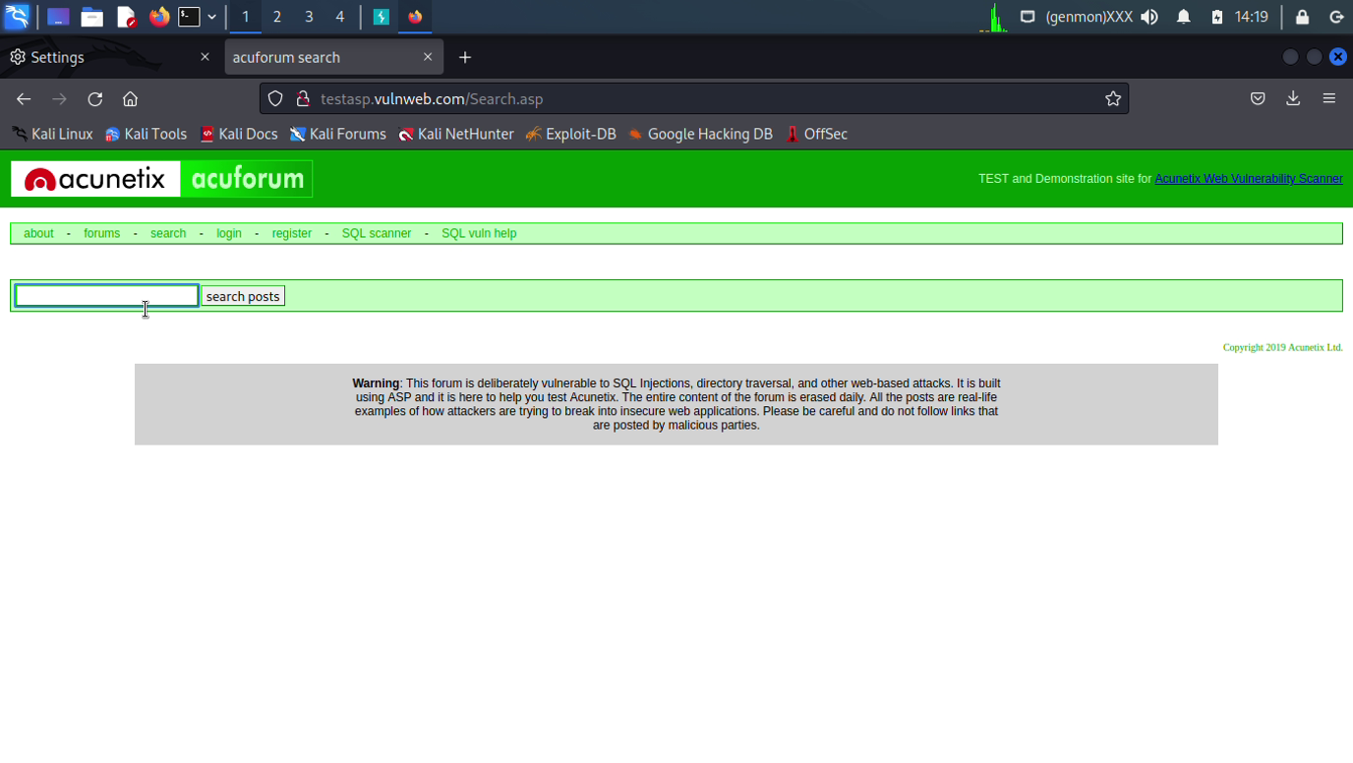

Slide 6
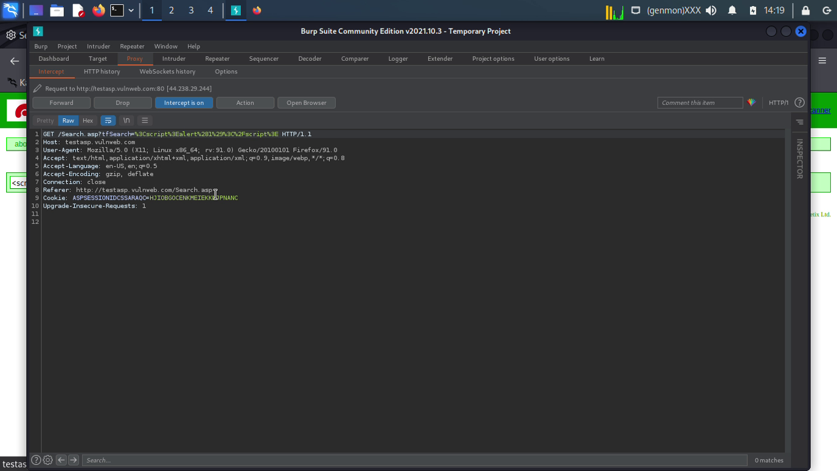

Slide 7
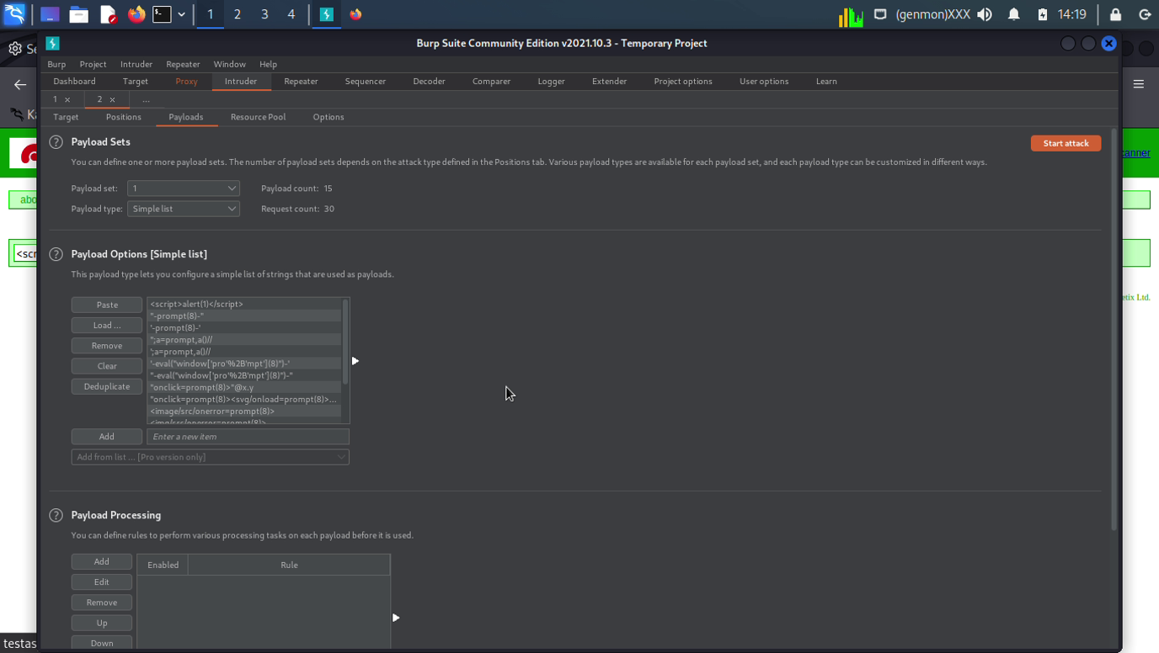

Slide 8
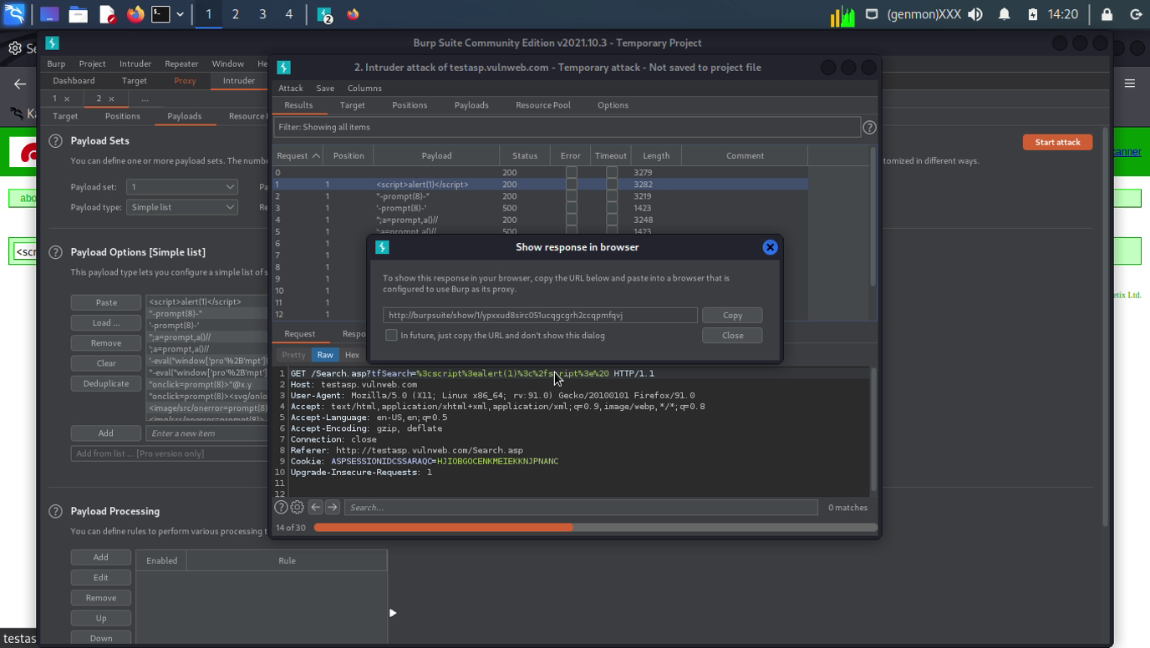

Slide 9
